Slide 1
NMGR P33 A/B NEW MODEL JUSTIFICATION
Backdoor manipulator modernization
Kadykov, Vladimir

Slide 2
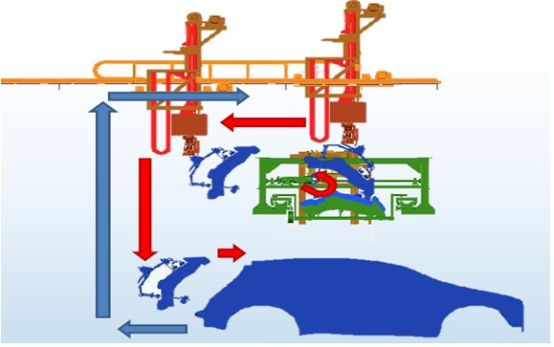
Project summary
Background
Due to the launch of a new models P33A/B, it is necessary to change the BackDoor installation equipment.
Scope of work
Modernization of the back door semi-automatic system
Project timing
Contract Feb`21
Manufacturing Sep`21
Installation Jan`22
Sign-off Jun`22
Budget
WBS-P-P33B2P/PT/PTC1/001
M Rub
14733 kRub
16960 KRub
2227 KRub
Backdoor manip. mod-n
budget
Saving
This PR
amount

Slide 3
Thank you

